Slide 1
Forensics 1
Chemistry and Physics in Forensics Analysis

Slide 2
Welcome to the Forensic Analysis Rookie Team.
You’ve been chosen because of your big brain to be a forensic analyst for F.A.R.T. Today is training day -- make sure to write good notes about the forensic analysis methods discussed for when you go on doody duty.
Notes:
F.A.R.T. is serious business… make sure to write good notes about the analysis methods for when you go on doody. You can copy and paste relevant images. The bare minimum that you should note down is indicated with the phrase *important information*.

Slide 3
01
Powders
02
Blood Spatters
TABLE OF CONTENTS
03
Hairs and Fibers
04
Finger Prints

Slide 4
POWDERS
Sometimes an analyst will find a mysterious powder. Analysts must determine what the powder is in case it’s illegal or provides a clue about the case.

Slide 5
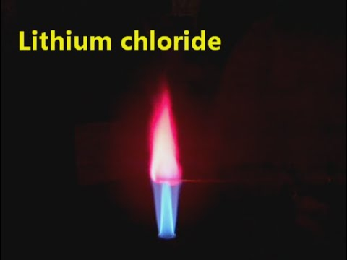
Powders: The burn test
Different elements, when burned, will turn flames different colors.
Notes:
Watch on x2 speed

Slide 6
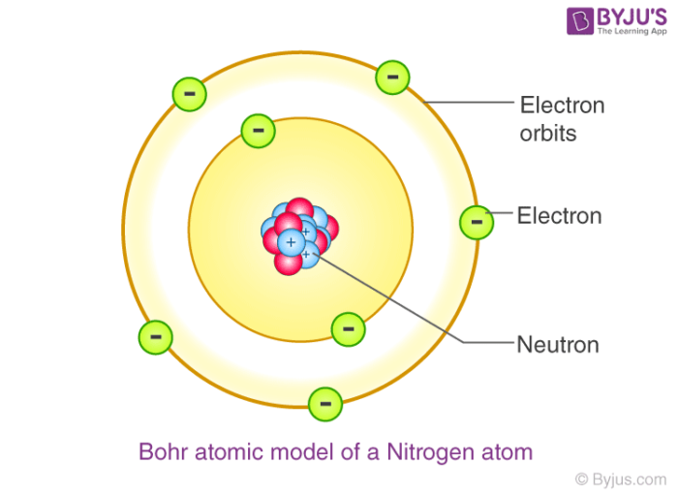
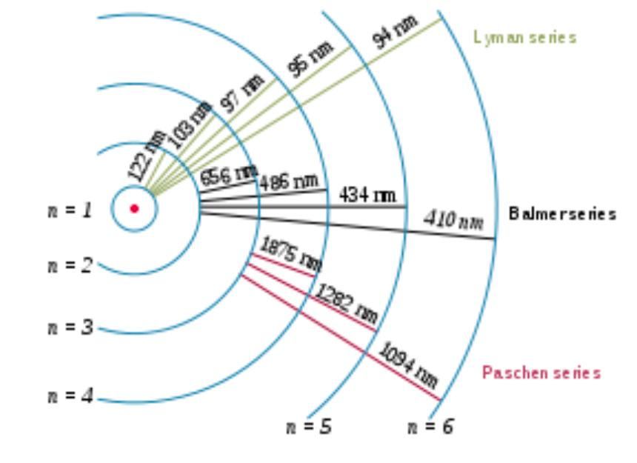
Why does this happen?
Bohr Model
Electrons become excited when heated
They will later release their energy as light

Slide 7
Some elements and their colors:
Sodium: golden yellow flame, very distinct.
Lithium: carmine or red flame
Calcium: yellow-red flame
Boric Acid: bright green flame, very visible
Ammonium Chloride: faint green flame
Potassium: light purple, lavender flame
Notes:
*Important information*

Slide 8
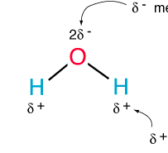
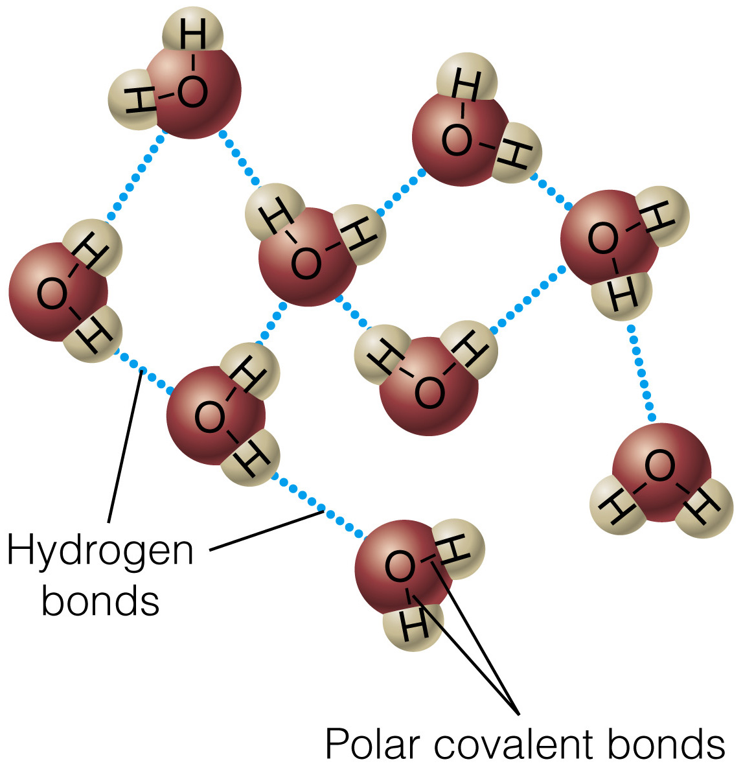
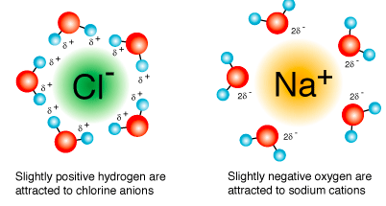
Powders: Solubility
Soluble: able to be dissolved in water
Water molecules are polar → hydrogen bonds, intramolecular bonds
Ions and polar molecules form intramolecular bonds w/ water molecules
Bond must release enough energy to break hydrogen bonds

Slide 9
Some materials and their solubility:
All samples can be divided into two fields--soluble and insoluble. Water is used to perform this test.
Soluble Samples: sodium acetate, sodium chloride, sodium hydrogen carbonate, sodium carbonate, lithium chloride, potassium chloride, calcium nitrate, glucose, sucrose, magnesium sulfate, boric acid, ammonium chloride
Non-soluble Samples: calcium sulfate, calcium carbonate, cornstarch
Notes:
*Important information*

Slide 10
Blood Spatters
Blood spatters can tell a lot about how an act of violence was conducted. Analysts must determine the angle, height, and speed at which an injury was delivered.

Slide 11
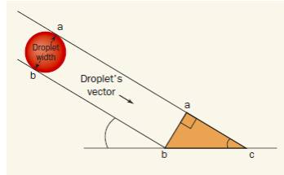
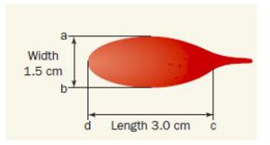
Angle of Impact
Use these diagrams to derive a formula for the angle theta of impact based on the width and length of the blood droplet. (Use trigonometry SOHCAHTOA)
The tail of the drop points in the direction it fell
Notes:
*Important information*

Slide 12
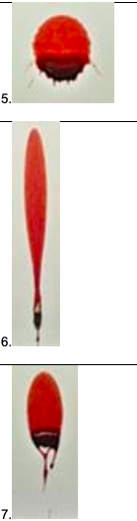
Angle of Impact: Practice
Estimate the angle of impact for these three blood spatters.

Slide 13
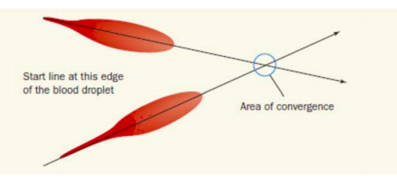
Height of Impact
Based on the diagram below and the information found earlier, how could you find the height of impact? (Look on next slide for hint)
Notes:
*Important information*

Slide 14
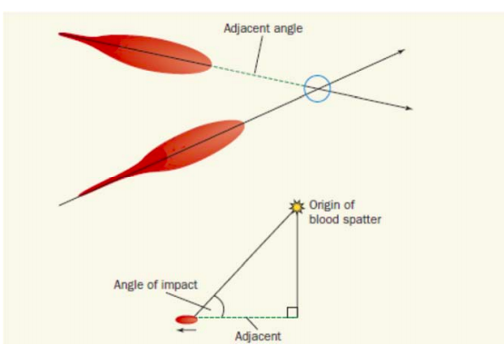
Height of Impact

Slide 15
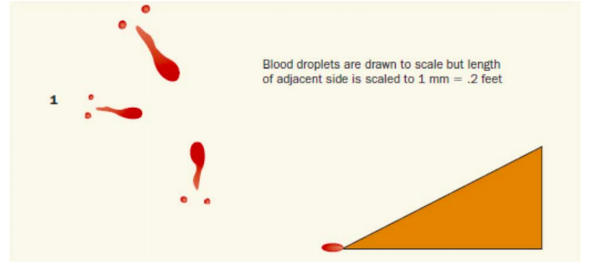
Height of impact: Practice
Notes:
(You can estimate lengths)

Slide 16
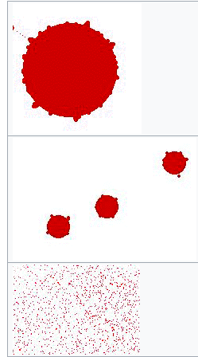
Low Velocity
Medium Velocity
High Velocity
Blood Spatter Velocity
Low velocity blood spatter can caused by blood dripping. For example blood dripping from a nosebleed. Low velocity blood spatter is 5 feet per second or less. This causes the blood droplets to be large in diameter (between 4 and 8mm.)
Medium velocity blood spatter can be caused by a beating with a blunt object. For example somebody getting beaten with a baseball bat. Medium velocity blood spatter is between 5 and 100 feet per second. This causes the droplets of blood to be smaller in diameter, and more like a spray.
High velocity blood spatter is usually caused by a gunshot, it can also be caused by other objects too if enough force is exerted. High velocity blood spatter is over 100 feet per second. This causes the pattern of the blood to be a fine spray. Each tiny droplet in a high velocity blood pattern less than 1mm in diameter.
Notes:
*important information*

Slide 17
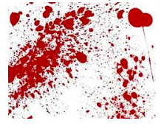
Blood Spatter Velocity Estimation: Practice
Do you think this blood spatter is high, medium, or low velocity?

Slide 18
Hair and Fibers
Sometimes Analysts will find a hair or fiber in the crime scene. They must identify what type of hair or fiber they found in order to find their origin for the case.

Slide 19
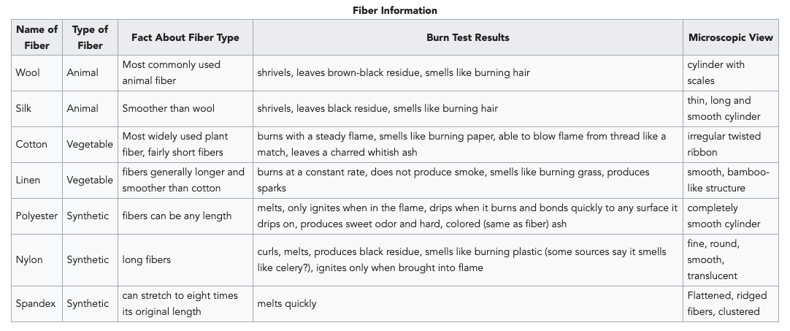
Fibers: Burn Test
Notes:
*Important information*

Slide 20
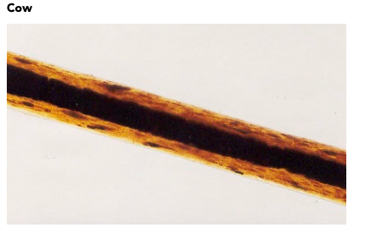
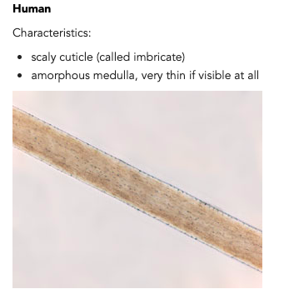
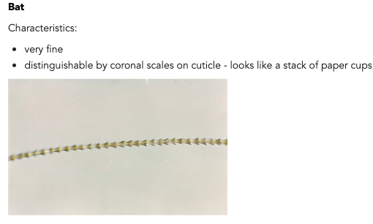
Hairs
Notes:
*Important Information*

Slide 21
Fingerprints
Fingerprints are the classic clue which can be found on the crime scene. Analysts can use them to identify who was at the scene of the crime and who handled any weapons found, so they must use various methods to search for them.

Slide 22
Fingerprinting methods
There are a lot, so here are some:
Dusting: Powder applied to prints sticks to fatty acids and lipids. This method involves using a brush to spread powder over prints. There are many powders. For example, you can use a dark-colored powder on a light-colored surface, or a fluorescent powder on a dark-colored surface.
Ninhydrin: A chemical method useful for lifting prints on paper. It reacts with amino acids in prints and generally tends to result in the latent print pattern being a purple color.
Wetwop: a special pre-mixed liquid formula that is designed to lift latent prints on the sticky sides of adhesive surfaces (i.e. most kinds of tape)

Slide 23
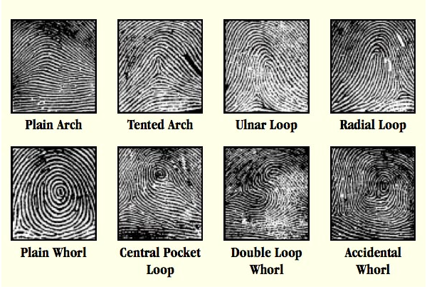
Fingerprint types
Notes:
*Important Information*

Slide 24
Good Luck, Rookies!!!

Slide 25
A bunch of links
https://scioly.org/wiki/index.php/Forensics#DNA
https://socratic.org/questions/why-do-different-elements-make-different-color-flames-when-you-burn-them#:~:text=When%20you%20heat%20an%20atom,emits%20a%20quantum%20of%20energy.&text=The%20different%20mix%20of%20energy,a%20characteristic%20flame%20emission%20spectrum.
https://www.stevespanglerscience.com/lab/experiments/flame-test/
https://www.chem.fsu.edu/chemlab/chm1020c/lecture%203/03.php#:~:text=The%20wavelengths%20and%20frequencies%20of,a%20different%20color%20is%20emitted.
https://wps.prenhall.com/wps/media/objects/3312/3391718/blb1303.html
http://chemed.chem.purdue.edu/genchem/topicreview/bp/ch18/soluble.php
https://apps.college.brown.edu/source/file/display/52/SOURCE-Lesson-Plan--Blood-Splatter.pdf
https://sites.google.com/site/bloodspatteranalysisforensics/bloodstain-pattern-analysis
http://wranatomyclass.weebly.com/uploads/1/3/3/7/13374819/lab_2-_blood_spatter_impact_angle.pdf
https://www.yalescientific.org/2010/05/everyday-qa-can-you-melt-a-wooden-log/#:~:text=The%20physical%20structure%20of%20wood,components%2C%20wood%20does%20not%20melt.
https://wonderopolis.org/wonder/why-do-some-things-burn-while-others-melt#:~:text=So%20why%20do%20some%20things%20burn%20while%20others%20melt%3F&text=Substances%20that%20burn%20instead%20of,is%20the%20case%20with%20wood.

